Slide 1

PrognosAI: AI-Driven Predictive Maintenance System Using Time-Series Sensor Data
Objective
To design an AI-based system that predicts equipment failure using time-series sensor data, enabling timely maintenance and minimizing downtime.
Tools & Frameworks
Python · TensorFlow · Keras · Streamlit · Docker
Presented by: Manjushree

Slide 2
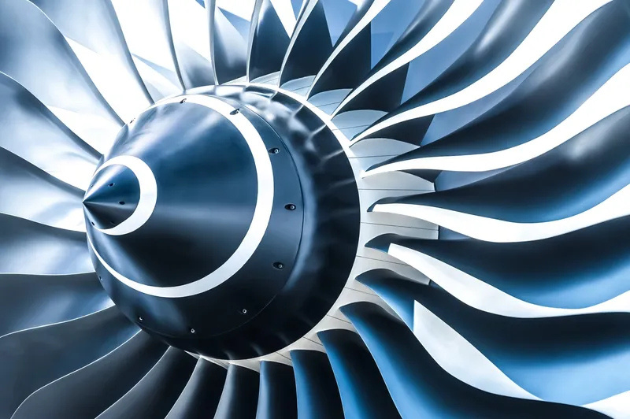
Table of contents
Milestone 1: Data Preparation & Feature Engineering
Milestone 2: Model Development
Milestone 3: Model Evaluation
Milestone 4: Risk Thresholding & Alert System
Milestone 5: Visualization & Dashboard
Conclusion & Future Work
References

Slide 3
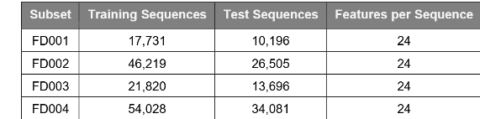

Milestone 1: Data Preparation & Feature Engineering
Objective:
Prepare CMAPSS sensor data for modeling.
Key Steps:
Cleaned raw time-series data (removed missing & noisy readings).
Normalized 21 sensor values using MinMaxScaler.
Calculated Remaining Useful Life (RUL) for each engine cycle.
Created rolling window sequences for model input.
Outcome:
Dataset ready for deep learning model training.

Slide 4
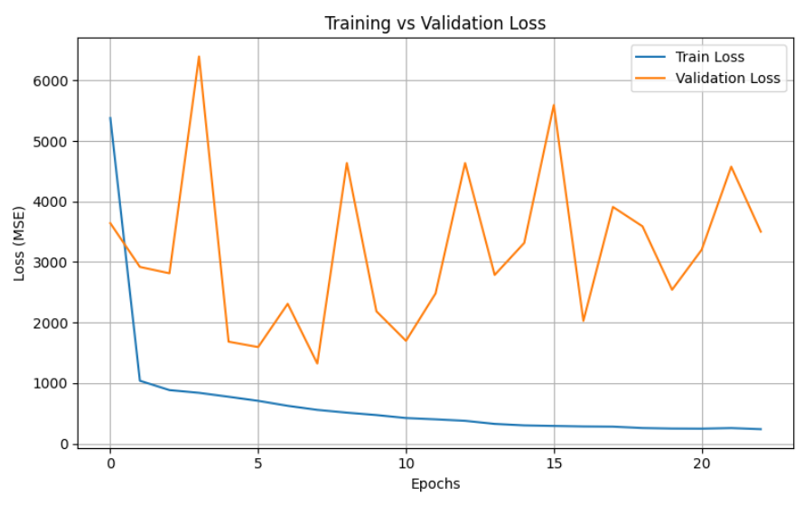
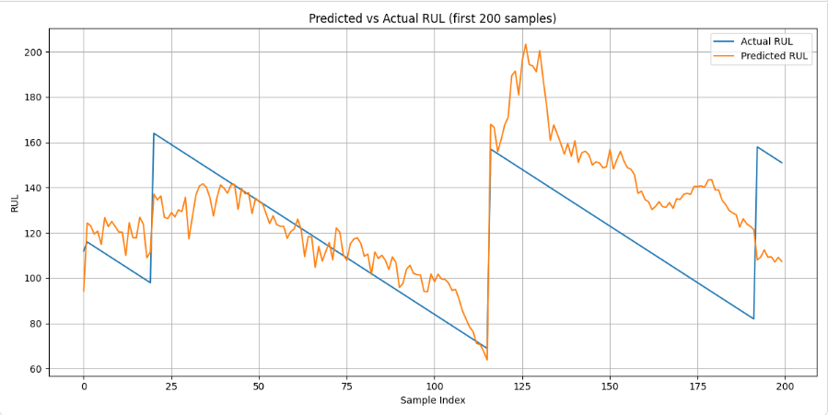
Milestone 2: Model Development
Goal:
Design and train a deep learning model to predict RUL.
Approach:
Implemented Bidirectional LSTM for sequence learning.
Layers: Bi-LSTM(128) → Dropout → Bi-LSTM(64) → Dense → Output
Optimizer: Adam | Loss: MSE | Epochs: 50 | Batch Size: 64
Outcome:
Trained model (optimized_fd1.h5) accurately captures temporal degradation patterns.

Slide 5
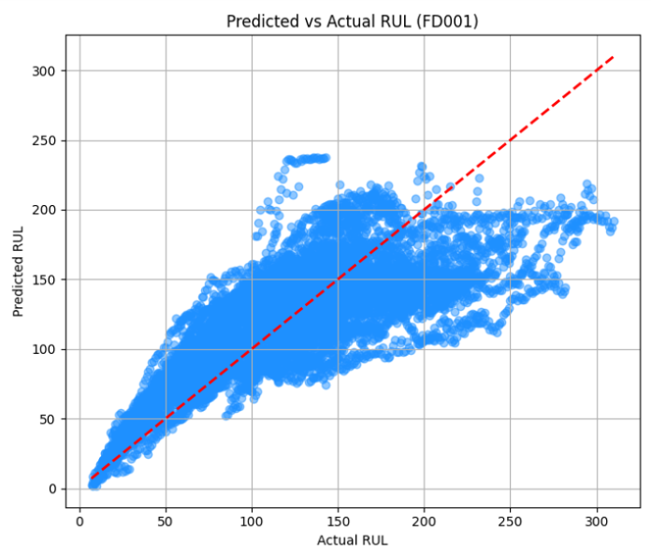
Milestone 3: Model Evaluation
Objective:
Evaluate model performance on unseen test data.
Metrics - Metric Value
RMSE - 35.3
MAE - 28.4
R² - 0.76
Insights:
Model successfully predicts future degradation.
Predicted RUL closely matches actual values.

Slide 6
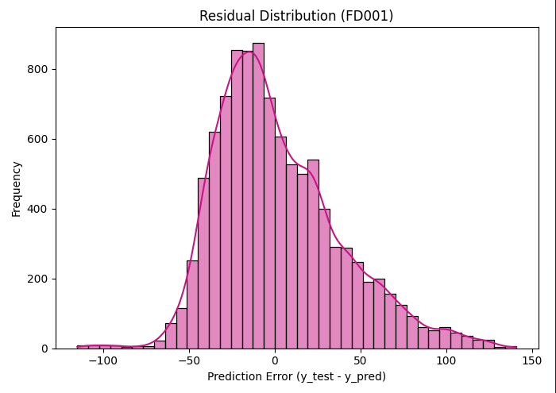
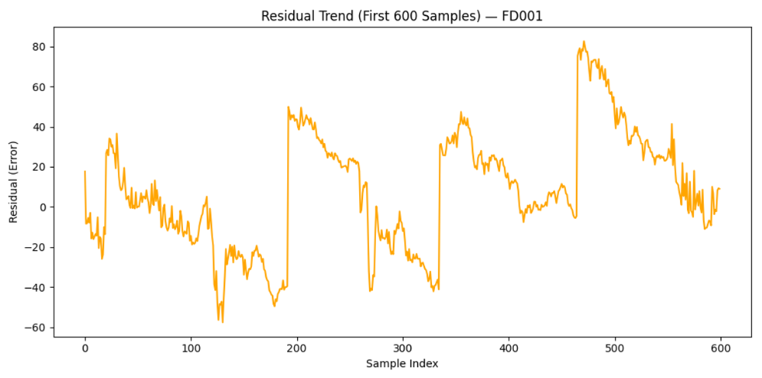
Milestone 4: Risk Thresholding & Alert System
Purpose:
Convert predicted RUL into actionable maintenance alerts.
Defined Alert Levels :
Alert Level - Condition - Color
Normal - RUL > 70 - 🟩 Green
Warning - RUL ≤ 50 - 🟧 Orange
Critical - RUL ≤ 20 - 🔴 Red
Outcome:
✅ CSV report generated showing alerts per engine cycle.
✅ Enables preventive maintenance decisions.

Slide 7
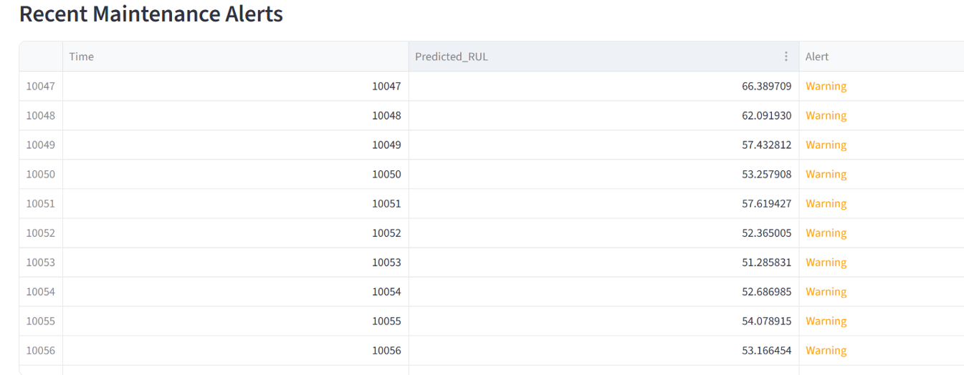
Milestone 5: Visualization & Dashboard
Tool Used: Streamlit
Features:
Interactive dashboard for RUL prediction visualization
Real-time alert color codes
Trend charts (Actual vs Predicted RUL)
Exportable maintenance summary
Outcome:
Complete, user-friendly dashboard for continuous monitoring.

Slide 8
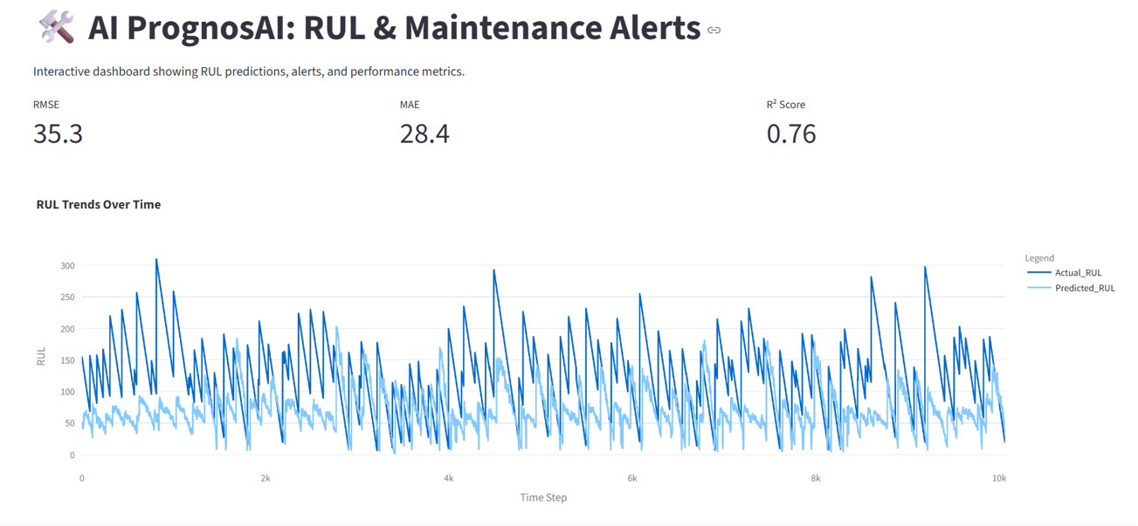
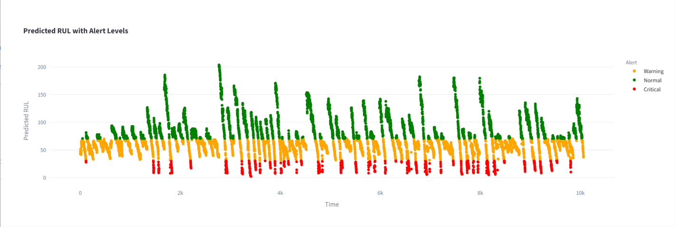


Slide 9
Conclusion & Future Work
Summary:
Built end-to-end Predictive Maintenance AI system
Achieved reliable RUL prediction accuracy
Reduced downtime through early alerting
Future Enhancements:
Integrate IoT sensor streams in real-time
Use Transformer-based deep models
Deploy on edge devices using Docker
Our financial performance is a reflection of our commitment to strategic planning, cost management, and operational efficiency. In the fiscal year 2024, we focused on enhancing profitability while ensuring compliance with financial regulations.

Slide 10
References
Learning & Development Resources:
Infosys Springboard Platform – https://infyspringboard.onwingspan.com
GeeksforGeeks – Tutorials on Machine Learning, Python & Deep Learning https://www.geeksforgeeks.org
Kaggle – Predictive Maintenance & CMAPSS Dataset Discussions https://www.kaggle.com
TensorFlow Documentation – Model building, training, and evaluation https://www.tensorflow.org
Keras API Reference – LSTM & Bi-LSTM implementation details https://keras.io/api
Streamlit Documentation – Building interactive dashboards https://docs.streamlit.io
1. Capital Expenditures (CapEx)
Upgrading machinery to enhance production efficiency and reduce waste.

Slide 11
thank you

